Slide 1
The ethics mindset
Navigating professional ethics in the digital age

Slide 2
Scenario 1
The instruction for your class is taught synchronous online. Part of a student's grade is based on participation points.
A student joins the class so that he or she can receive the participation points but regularly turns off their camera and works on homework assignments for other classes and sometimes plays video games during the class time.
How would you think that your students would respond if you ask them whether or not they participated ethically?

Slide 3
Scenario 2
In today's learning session, many of you might have your camera off or be multi-tasking during the session. Many of you might be earning CPE from participating.
How would you respond if I asked you whether or not you are participating ethically?

Slide 4
Professional ethics are even more challenging in the digital age
We communicate and engage with others mostly through technology now. As a result, boundaries are different and less understood about what and how things should be communicated and shared and with whom.
It’s easier to communicate and share more quickly, often and even anonymously.
Communications are briefer and reactionary, rather than being well explained and well thought out.
Sensitive information is more easily accessible and distributable.
There is greater use of virtual sources of information deemed as authoritative without appropriate vetting.
There is greater expression of opinion and influence from what others think because of the degree of connectedness, especially with peers.
There is a greater need to use a broad array of technology and resources, including online research and collaboration with others, for learning purposes. However, when the use of these skills and resources is prohibited for learning assessments, adherence to these boundaries becomes more difficult (e.g., greater risk of cheating).
Data and deliverables can be easily altered.
There are greater distractions when completing tasks due to the number of devices we manage and the degree of our connectedness.
There is greater use of virtual platforms to interact in a learning or work setting, which can cause individuals to believe there is less oversight and accountability compared with an in-person setting.
Virtual platform settings can be manipulated to misrepresent the level of engagement.
Security permissions for digital tools and accounts are not well understood or managed in an appropriate way.
Notes:
Emphasis is challenge with boundaries, access, ability to manipulate, accountability, and influence of others. All of these challenges are being seen within our profession and probably more so with our younger people. But we also know these challenges are not unique to our profession and certainly, don’t start there. The challenges exist in higher ed as well.

Slide 5
Students begin their professional journey while in higher ed
While at the end of their academic journey, students are at the beginning of their professional journey. Professional ethics expectations don’t wait until they start their career.
The ethical choices they make now will reflect heavily on them as a professional, and potentially even limit their ability to enter the profession.
The ethics mindset they build while in school is an important skillset for their ability to practice professionally.
Students need to understand that the professional ethics bar is high!
Unknown Author is licensed under

Slide 6
Keeping an eye on students

Slide 7
What is an ethics mindset?
To have an ethics mindset, you must:
Desire to do what is right
Understand what is right and wrong
Avoid doing what is wrong
Commit to and do what is right

Slide 8
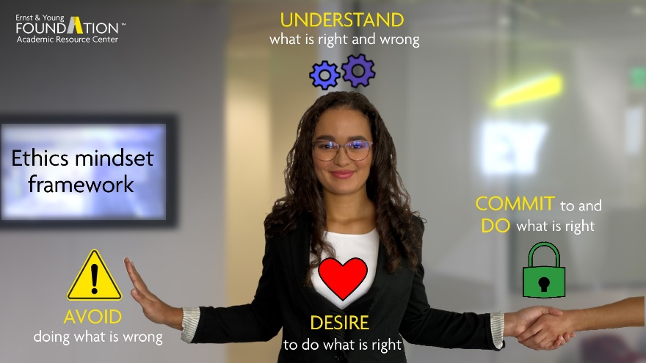
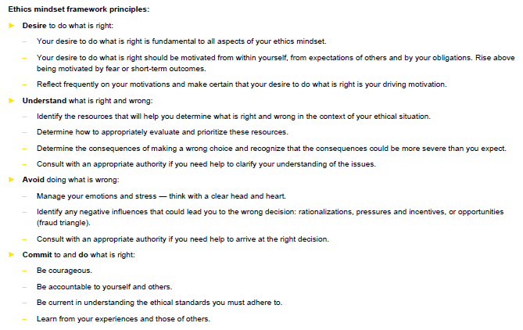
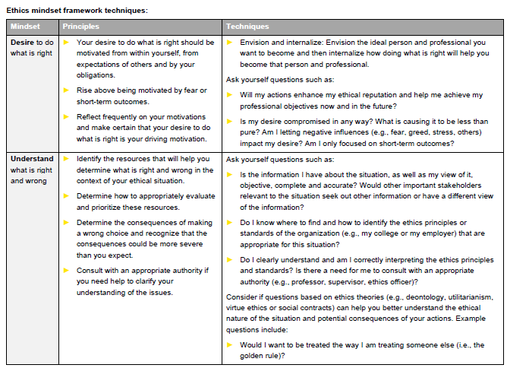
Ethics mindset framework
Definition
Visual
Principles
Techniques
Notes:
The framework handout includes:
A definition of the ethics mindset.
A visual to help reinforce the definition of the ethics mindset.
Principles that underlie the definition to help provide students with more context for each component of the definition.
Techniques to help develop the ethics mindset are also provided. Please note that while the techniques are not intended to be comprehensive, they should provide a good foundation for the students.
This handout should be provided to students before completing the exercises or any case studies for easy reference. It can also be used by students beyond this material.

Slide 9
Notes:
With this visual, it is important to emphasize to students that they should always start with a desire to do what is right (their heart) and that this should always remain at the center of the mindset. From there, it also includes their head to understand what is right and wrong, through learning and critical thinking. At the left, you’ll see a hand indicating avoidance of doing what is wrong, indicated by a warning sign (a triangle shape, which is also aligned later with the fraud triangle), which emphasizes that there is always a slippery slope to avoid. Lastly, at the right, you’ll see a lock and handshake, indicating commitment and action. This is where implementing the ethics mindset becomes real in practice and emphasizes the inclusion of others as well.

Slide 10
Principles
Desire to do what is right:
Your desire to do what is right is fundamental to all aspects of your ethics mindset.
Your desire to do what is right should be motivated from within yourself, from expectations of others and by your obligations. Rise above being motivated by fear or short-term outcomes.
Reflect frequently on your motivations and make certain that your desire to do what is right is your driving motivation.
Understand what is right and wrong:
Identify the resources that will help you determine what is right and wrong in the context of your ethical situation.
Determine how to appropriately evaluate and prioritize these resources.
Determine the consequences of making a wrong choice and recognize that the consequences could be more severe than you expect.
Consult with an appropriate authority if you need help to clarify your understanding of the issues.
Avoid doing what is wrong:
Manage your emotions and stress — think with a clear head and heart.
Identify any negative influences that could lead you to the wrong decision: rationalizations, pressures and incentives, or opportunities (fraud triangle).
Consult with an appropriate authority if you need help to arrive at the right decision.
Commit to and do what is right:
Be courageous.
Be accountable to yourself and others.
Be current in understanding the ethical standards you must adhere to.
Learn from your experiences and those of others.

Slide 11
Desire to do what is right Techniques
Envision and internalize: envision the ideal person and professional you want to become and then internalize how doing what is right will help you become that person and professional.
Ask yourself questions, such as:
Will my actions enhance my ethical reputation and help me achieve my professional objectives now and in the future?
Is my desire compromised in any way? What is causing it to be less than pure?
Am I letting negative influences (e.g., fear, greed, stress, others) impact my desire?
Am I only focused on short-term outcomes?

Slide 12
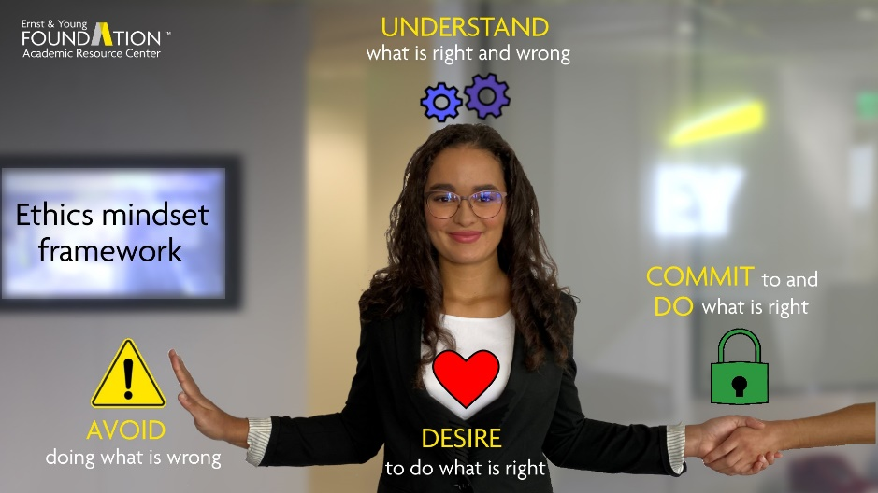
Application of framework to scenarios
Scenario 1
The instruction for your class is taught synchronous online. Part of a student's grade is based on participation points.
A student joins the class so that he or she can receive the participation points but regularly turns off their camera and works on homework assignments for other classes and sometimes plays video games during the class time.
How would you think that your students would respond if you ask them whether or not they participated ethically?
Scenario 2
In today's learning session, many of you might have your camera off or be multi-tasking during the session. Many of you might be earning CPE from participating.
How would you respond if I asked you whether or not you are participating ethically?

Slide 14
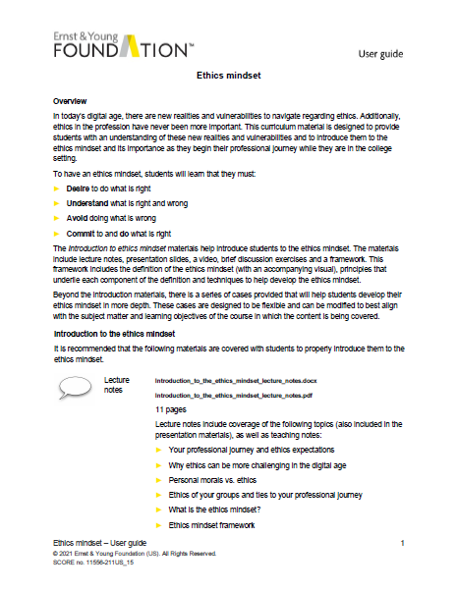
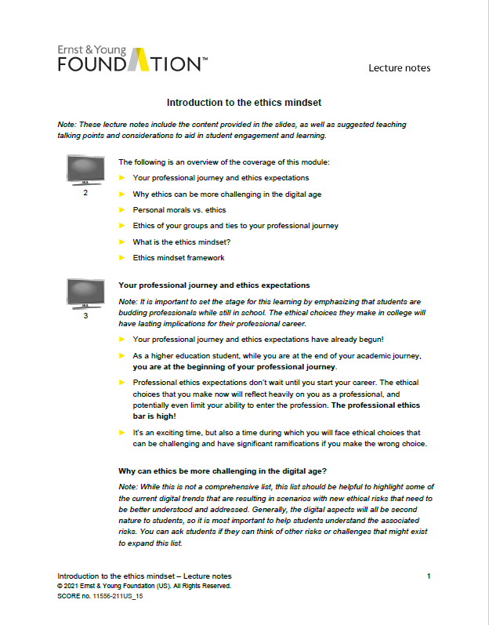
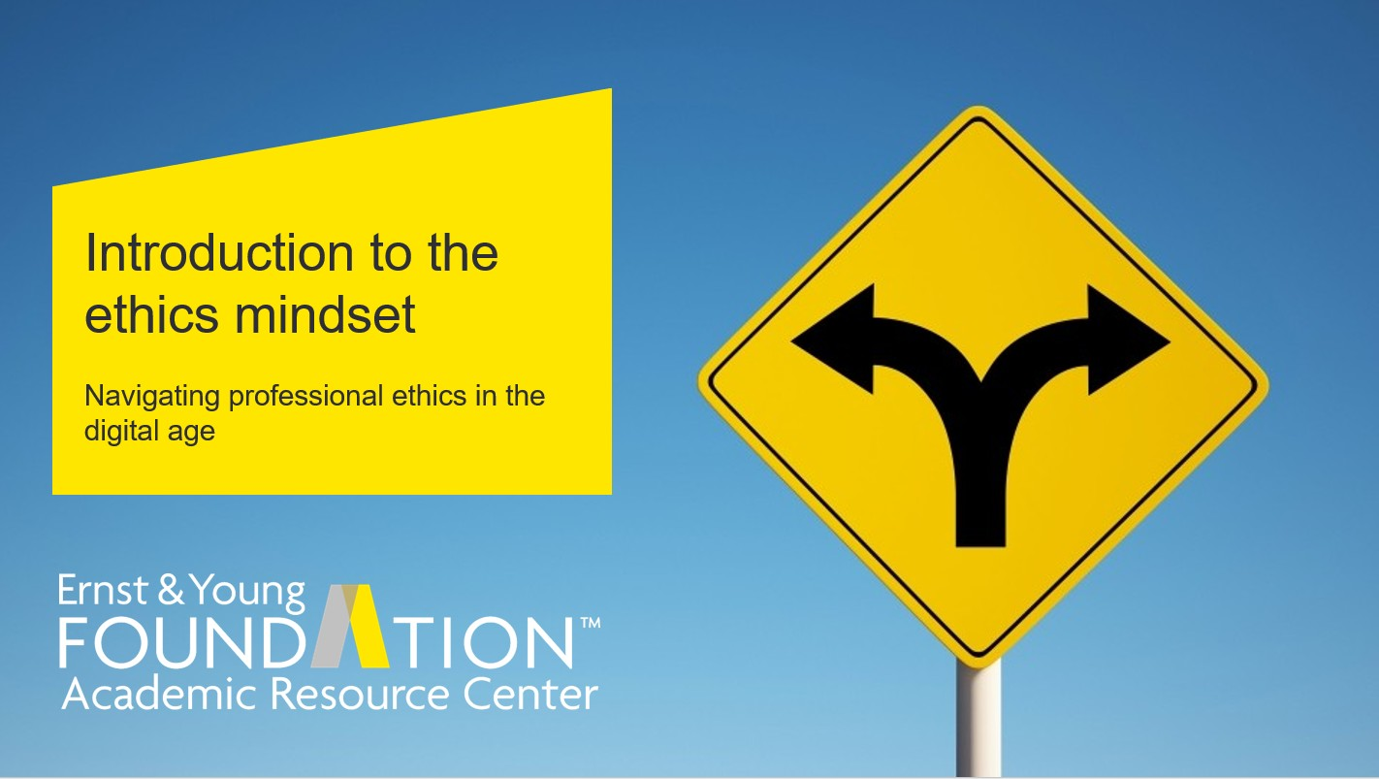
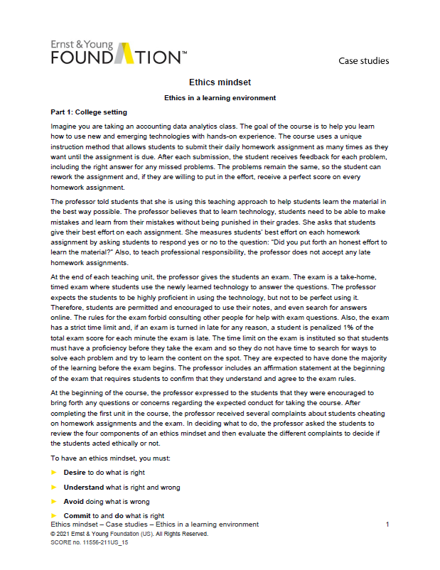
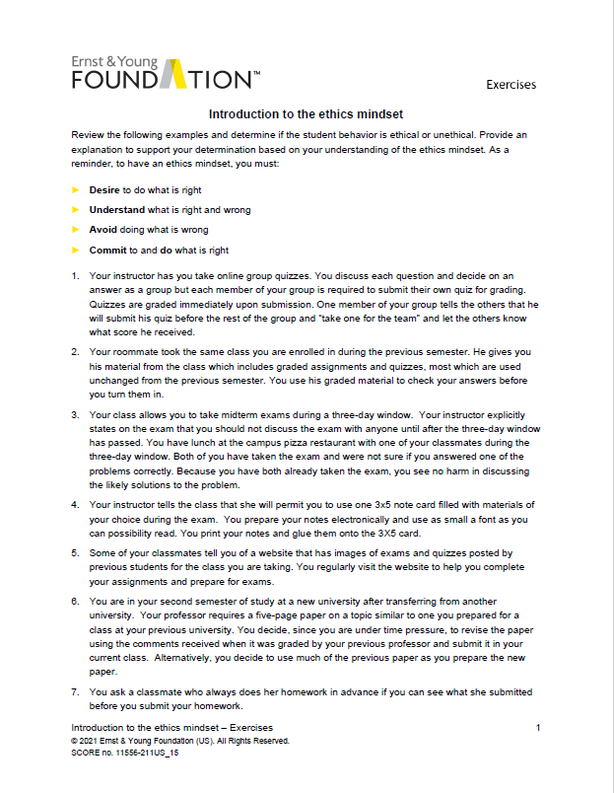
Ethics mindset framework curriculum
User guide
Lecture notes
Presentation
Coverage
Your professional journey and ethics expectations
Why ethics can be more challenging in the digital age
Personal morals vs. ethics
The ethics of your groups and ties to your professional journey
What is an ethics mindset?
Ethics mindset framework
Conclusion
Framework handout
Two videos
Exercises
Five cases
Ethics in a learning environment
The slippery slope
Sharing data and information
Inspire yourself and others
Social media
Notes:
Lecture and presentation includes

Slide 15
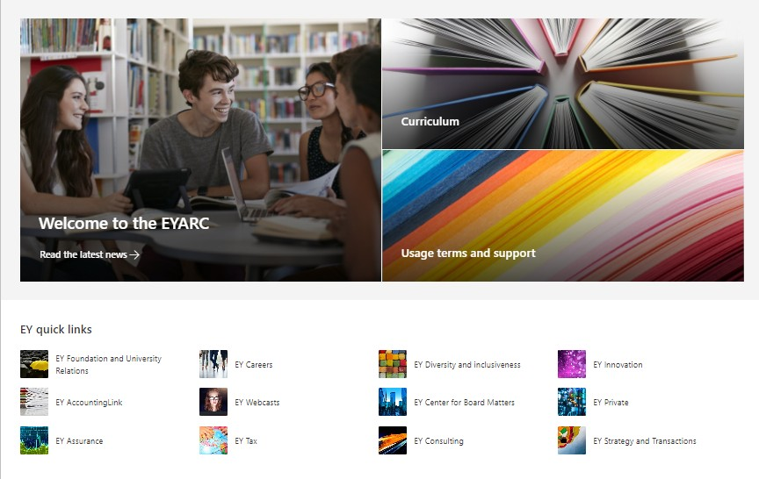
New EYARC website!
Contact us at eyarc@ey.com if you need an account or need to reactivate your account
Provide your organization email that you use for login to your organization. We use Microsoft Azure authentication for our website.
Most schools utilize Microsoft Azure for their authentication also so this can provide an SSO experience for you and align your login at your school with our website login.
Login in www.ey.com/us/arc.
If you have our site bookmarked and it does not redirect you to eyus.sharepoint.com then your bookmark won’t work. Update it to this URL.

Slide 16
Conclusion
Use your ethics mindset to navigate the ever-evolving ethical challenges you will face, especially in the digital age.

Slide 17
EY | Building a better working world
EY exists to build a better working world, helping to create long-term value for clients, people and society and build trust in the capital markets.
Enabled by data and technology, diverse EY teams in over 150 countries provide trust through assurance and help clients grow, transform and operate.
Working across assurance, consulting, law, strategy, tax and transactions, EY teams ask better questions to find new answers for the complex issues facing our world today.
EY refers to the global organization, and may refer to one or more, of the member firms of Ernst & Young Global Limited, each of which is a separate legal entity. Ernst & Young Global Limited, a UK company limited by guarantee, does not provide services to clients. Information about how EY collects and uses personal data and a description of the rights individuals have under data privacy legislation are available via ey.com/privacy. For more information about our organization, please visit ey.com.
Ernst & Young LLP is a client-serving member firm of Ernst & Young Global Limited operating in the US.
About the Ernst & Young Foundation
The Ernst & Young Foundation is a 501(c)(3) tax-exempt corporation associated with Ernst & Young LLP, which funds the Foundation, together with its present and former partners, principals and staff.
About the Ernst & Young Academic Resource Center
The Ernst & Young Academic Resource Center (EYARC) is an innovative collaboration between faculty and professionals to support higher education. The EYARC develops and provides free curriculum resources and other educational support to address leading-edge issues impacting the accounting profession. The EYARC is yet another example of the commitment of the global EY organization and the Ernst & Young Foundation to the academic community.
© 2021 Ernst & Young Foundation (US).
All Rights Reserved.
ey.com/us/arc

